Slide 1

Customer Shopping Behavior Analysis

Slide 2

Project Overview & Objectives
This project analyzes customer shopping behavior using transactional data to extract actionable business insights.
1
Customer Segmentation
Identify distinct customer groups for targeted strategies.
2
Spending Behavior
Understand purchasing patterns and value.
3
Product Performance
Evaluate product success and demand.
4
Discount Effectiveness
Assess the impact of promotions on sales.

Slide 3

Dataset Summary
Our analysis is based on 3,900 customer purchases across 18 columns, covering key data categories.
Customer Information
Age, Gender, Location
Subscription Status
Purchase Details
Item, Category, Amount
Season, Size, Color
Behavioral Data
Discount, Promo Code
Previous Purchases
Frequency, Review Rating
Shipping Type
Note: 37 missing values were found in the Review Rating column.

Slide 4
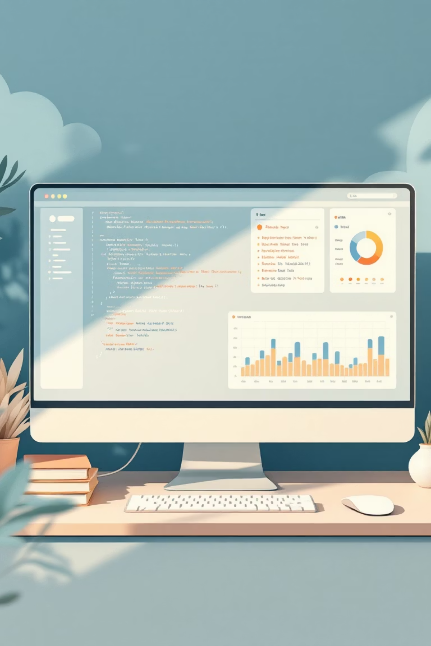
Data Preparation & EDA (Python)
Python was crucial for initial data exploration and cleaning, ensuring data quality for analysis.
01
02
Data Loading & Structure Analysis
Missing Values Handling
Addressed missing review ratings to maintain data integrity.
Imported dataset, inspected data types, and identified missing values.
03
Basic Explorations
Analyzed purchase amounts, demographics, and discount usage.

Slide 5


Feature Engineering & Database Integration
We refined the dataset through standardization, feature engineering, and validation before integrating with PostgreSQL.
Column Standardization
Converted column names to snake_case for consistency.
Feature Engineering
Created 'age_group' and 'purchase_frequency_days'.
Data Consistency
Removed redundant 'promo_code_used' column.
Database Integration
Loaded cleaned data into PostgreSQL for efficient SQL analysis.

Slide 6
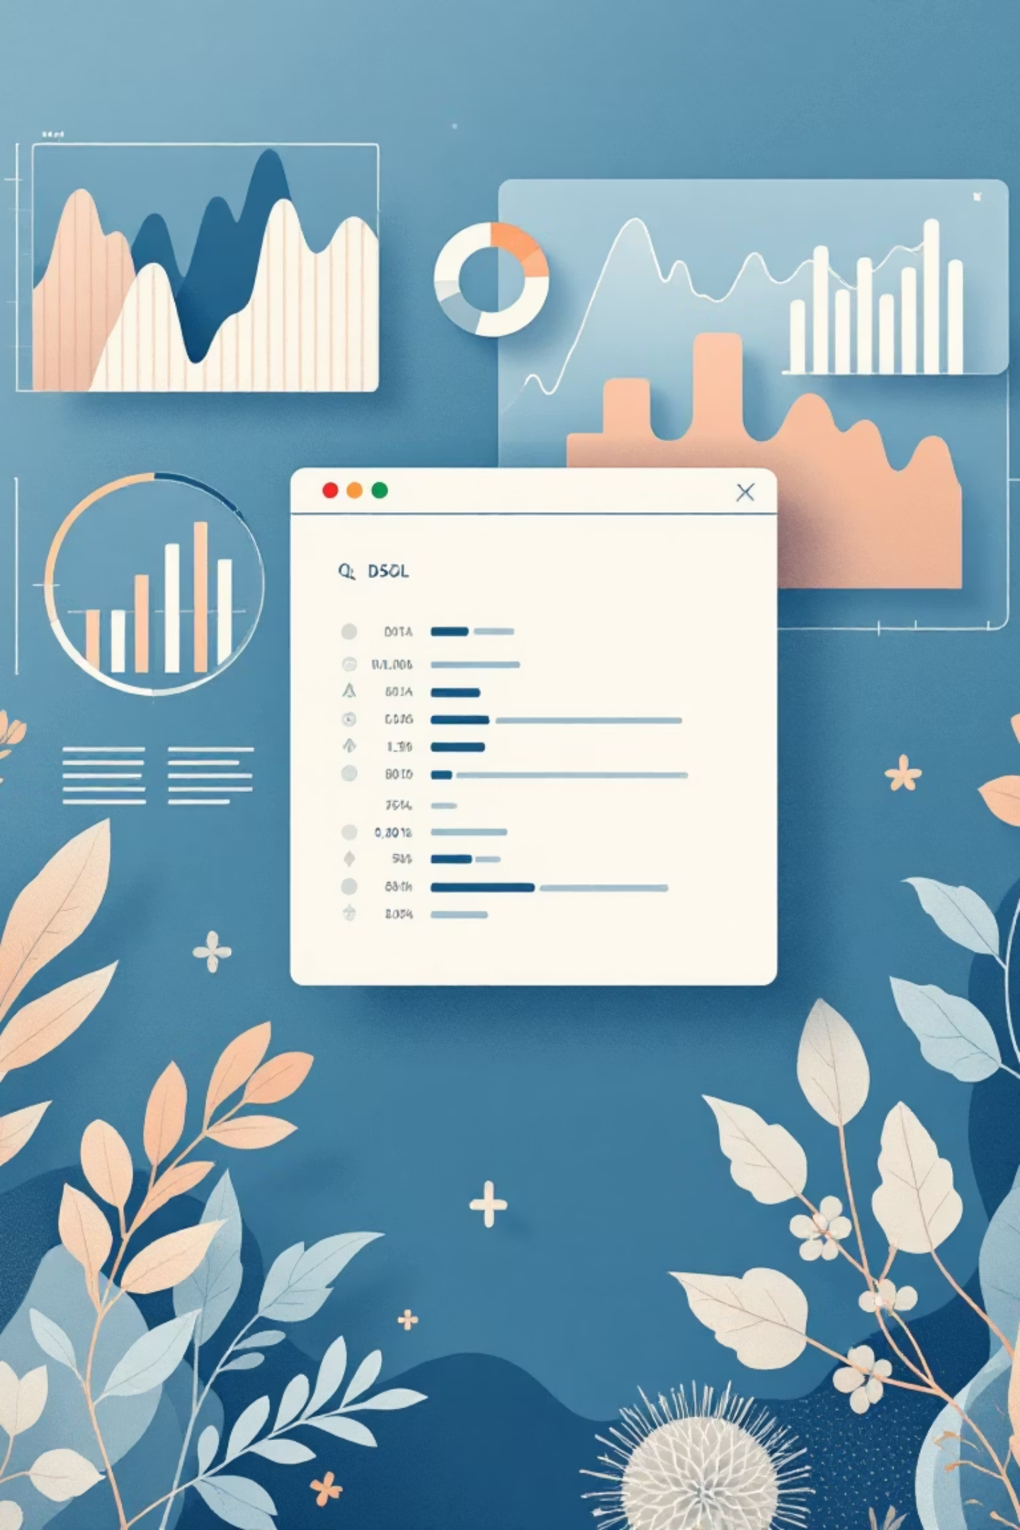
SQL Analysis: Key Insights
SQL queries revealed critical patterns in customer behavior and product performance.
Revenue by Gender
1
Identified purchasing power differences between genders.
High-Value Customers
2
Found discount users who still spend above average.
Top 5 Products
3
Ranked products by average review rating.
Shipping Impact
4
Compared purchase amounts by shipping type.

Slide 7



SQL Analysis: Subscription & Segmentation
Further SQL analysis focused on subscription impact and customer lifecycle segmentation.
Subscriber vs. Non-Subscriber Spending
Products with Highest Discount Utilization
Customer Segmentation
Assessed financial impact and effectiveness of subscription programs.
Identified products most reliant on promotional pricing.
Loyal
15% - High value customers
Returning
Customer Segmentation
35% - Regular shoppers
Categorized customers into New, Returning, and Loyal based on purchase history.
New
50% - First-time buyers

Slide 8
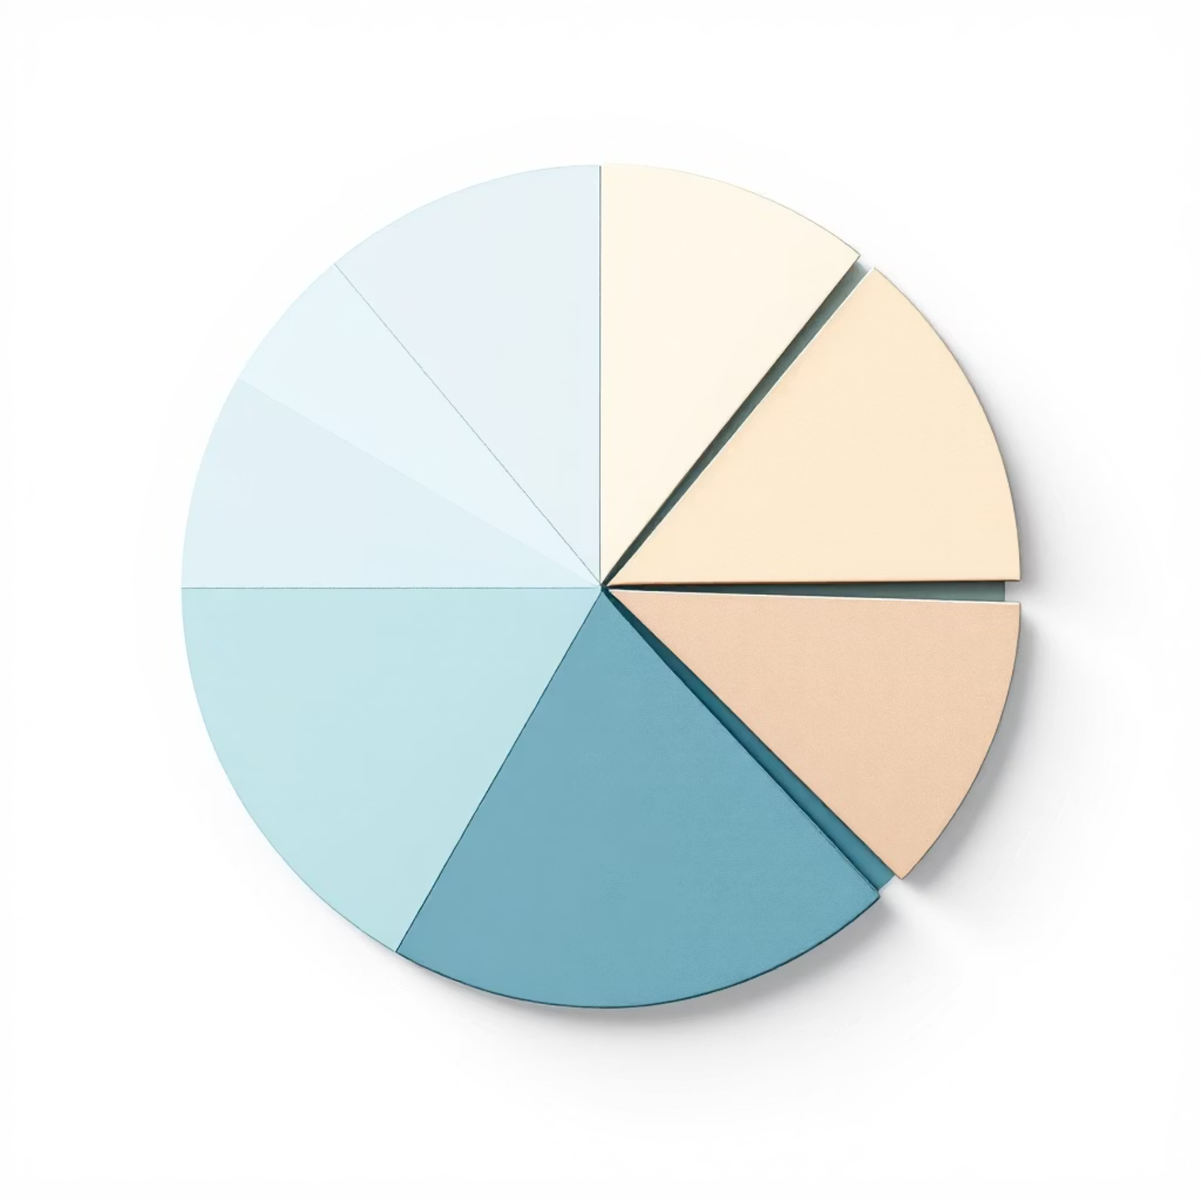


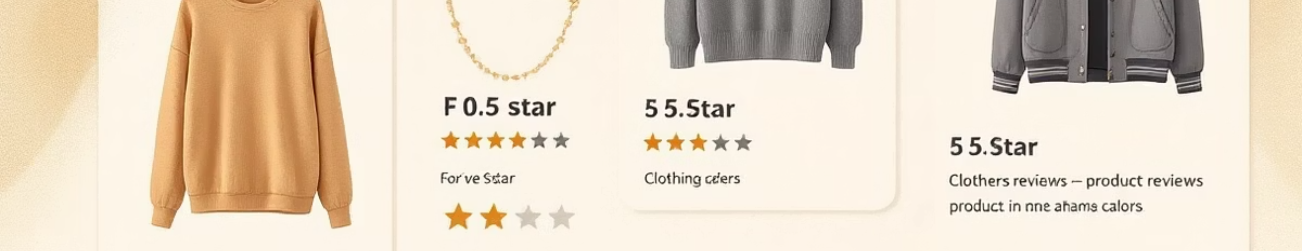
SQL Analysis: Top Products & Age Group Revenue
Revenue Contribution by Age Group
We identified top-performing products per category and revenue contributions by age group.
Identified most valuable age segments for targeted marketing.
Top 3 Most Purchased Products per Category
Highlighted category-level bestsellers for inventory and merchandising.
Blouse Dress Shirt

Slide 9

Interactive Dashboard in Power BI
All insights were consolidated into an interactive Power BI dashboard for visual presentation and data-driven decision-making.
This dashboard allows stakeholders to explore data and insights dynamically.

Slide 10
Business Recommendations
Leveraging our analysis, we propose actionable strategies to optimize business performance.
Target High-Value Segments
Strategic Discounts
Focus marketing on top-revenue customer groups.
Apply promotions selectively to maximize ROI.
Promote Top Products
Enhance Subscriptions
Highlight highly-rated items in campaigns.
Improve benefits for retention, especially for loyal customers.
Optimize Shipping
Segment-Specific Strategies
Incentivize Express shipping for high-value orders.
Tailor actions for New, Returning, and Loyal customers.

